Slide 1
A project brought to you by

Slide 2
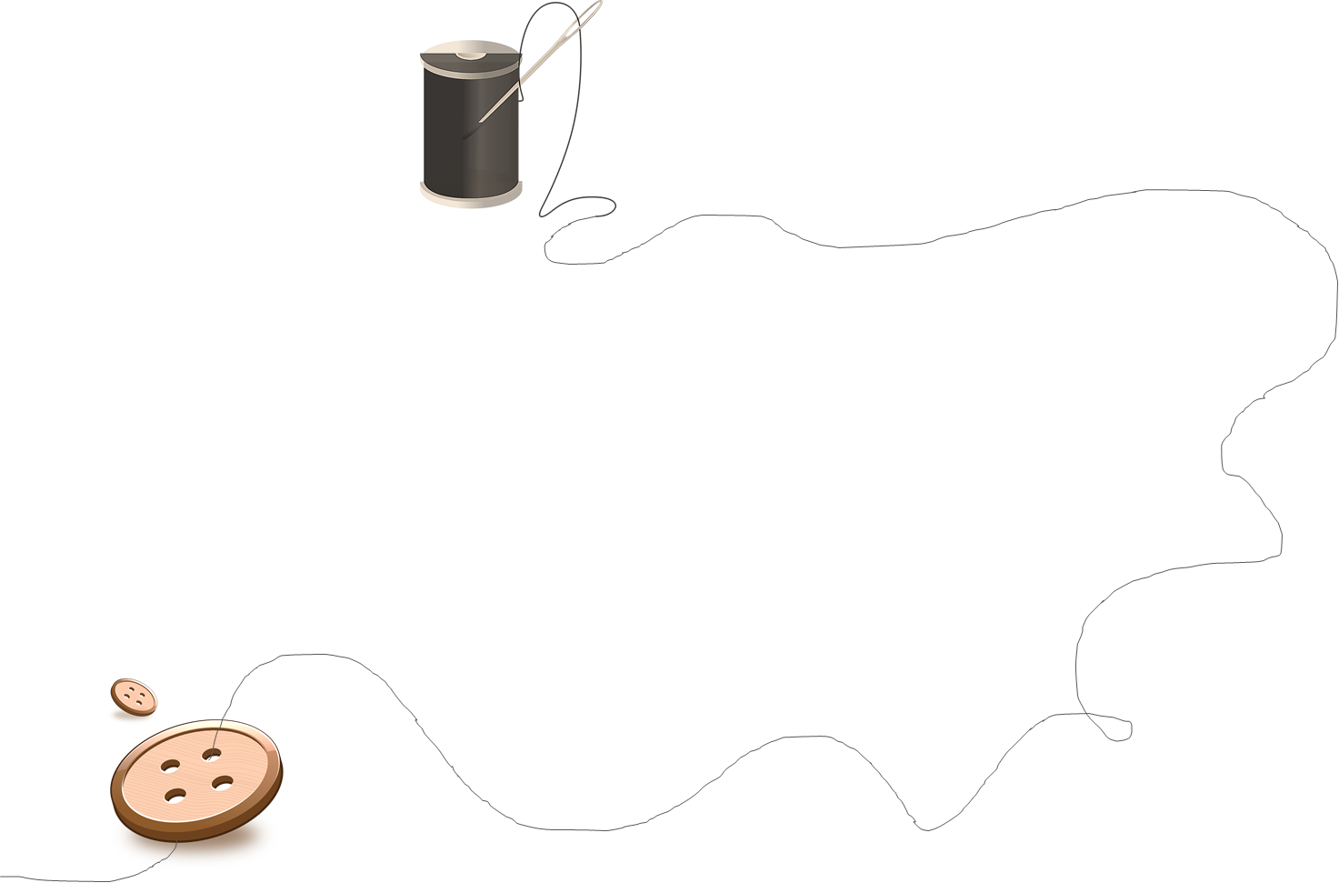
Purpose
To divert goods from landfill and challenge throwaway culture
To give people an opportunity to share and learn skills
To provide a networking space in the community.

Slide 3
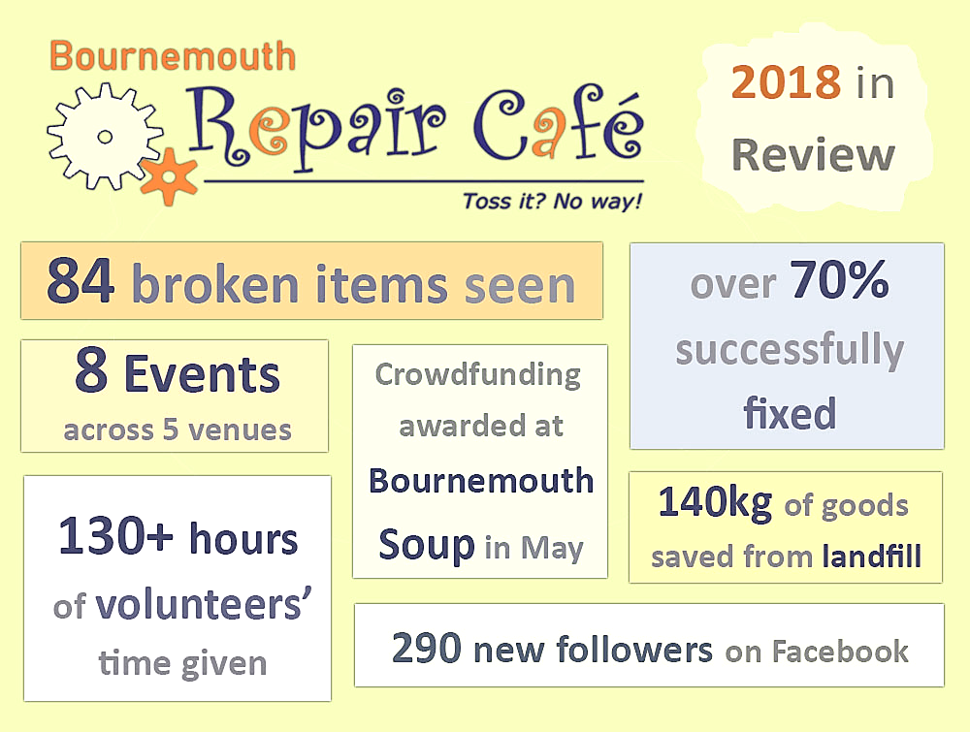

Slide 4
What’s coming up?
Other Dorset Repair Cafés in their initial stages
Always looking for new volunteers and ideas
Get in touch: transitionbournemouth@gmail.com www.facebook.com/RepairCafeBH

